Slide 1

Project: HS321-Principles of Management Systems
Guided by: Dr. Ravi
Email: ravi@iist.ac.in
Team Members:
Saurabh Kumar (SC22B145)
Saurabh Kumar (SC22B146)
Ankit Raj (SC22B087)
Aaditya Raj Anand (SC22B082)
Anurag (SC22B125)
Kumar Ajit (SC22B123)
Uttam Kumar (SC22B156)
Ram Ratan Kumar (SC22B110)
Aditya Sharma (SC22B084)

Slide 2
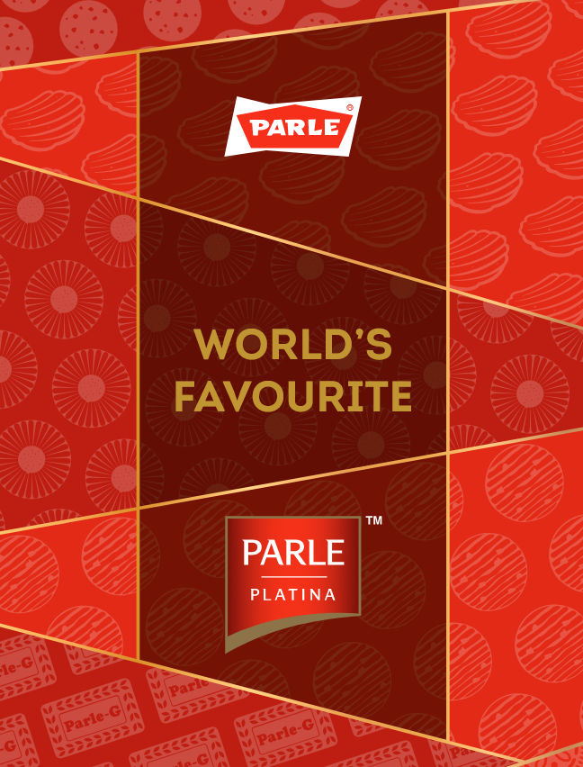
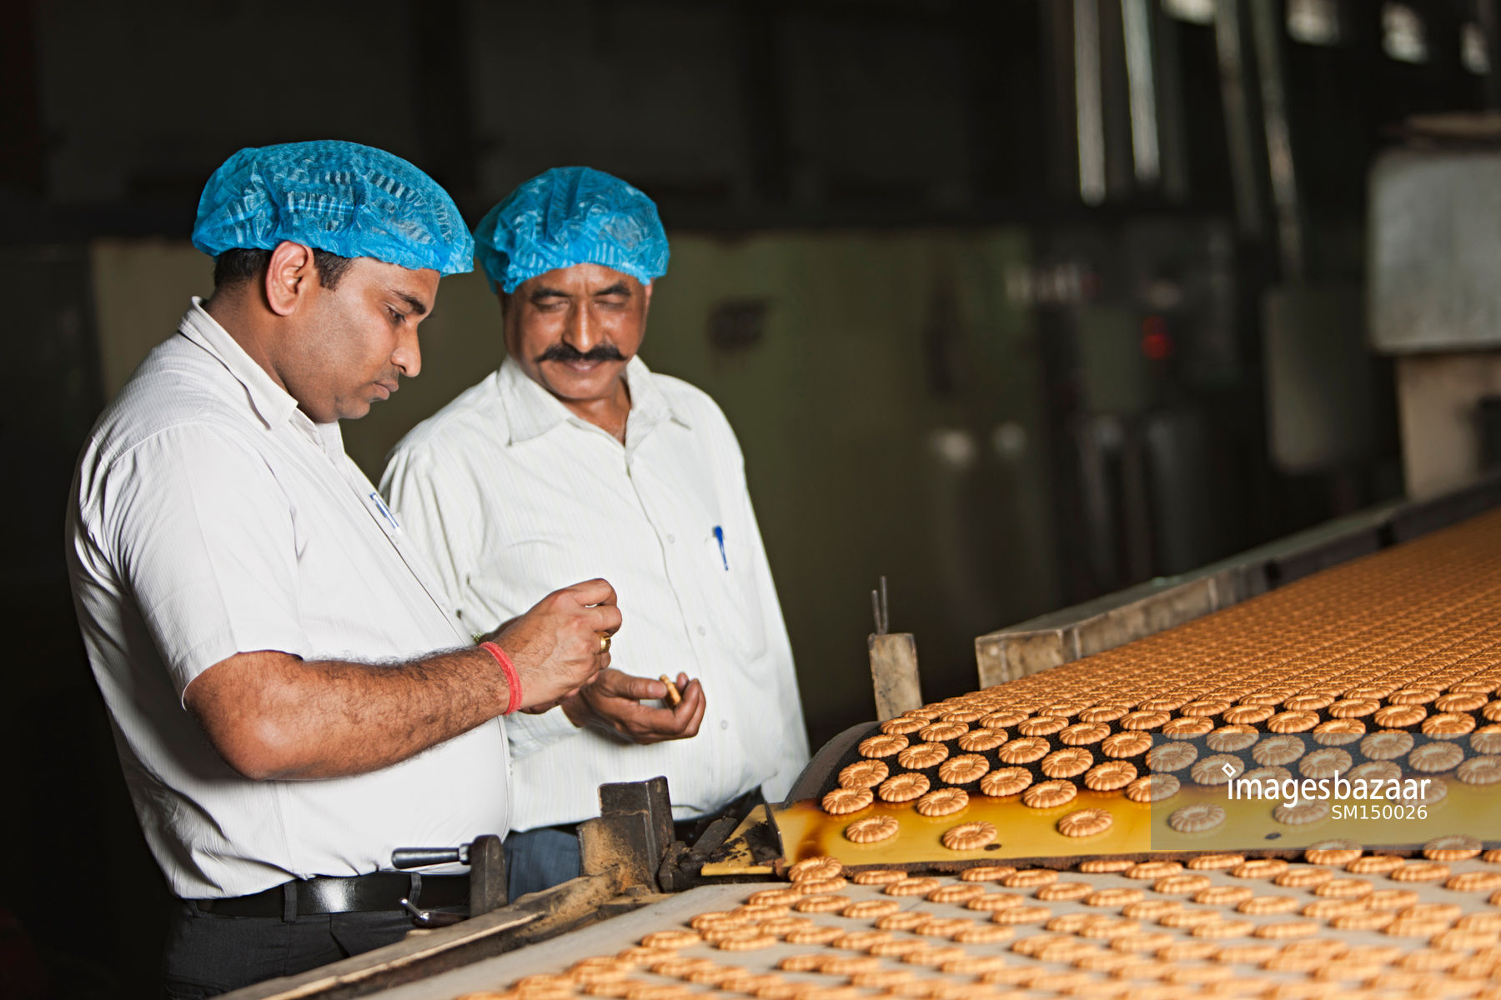
Company: Parle Products

Slide 3
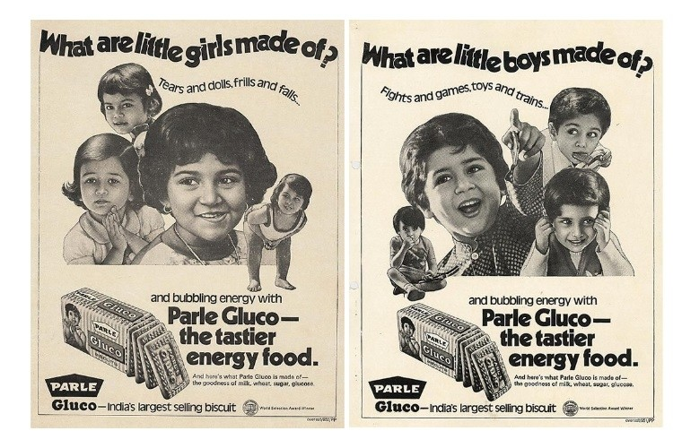
The Swadeshi Biscuit: Parle-G's Humble Beginnings
Biscuits and candies : imported and only in plates of rich
1929: Narottam Mohanlal Dayal of the Chauhan,a tailor in ville parle.
Swadeshi movement: get inspired and went to Germany to learn confectionery and returned with equipments and knowledge of confectionery trade.
Started with 12 family members.
First product: orange candies and toffee
1939: first biscuit product parle gluco, demanding in WWII for soldiers. And Monaco same year.
1941-50: longest oven in india; innovative packaging
Notes:
Early history and founding. Source: financialexpress.com

Slide 4
History with timeline
1951-1960:With the launch of Cheeslings in 1956, the nation found a new way to enjoy cheese snacks.
1961-70:Parle gets a whole lot sweeter! with Kismi in 1963 and Poppins in 1966.
1971-80:In 1972, we introduced the original sweet and salty biscuit, Krackjack.
Also received monde selection award.
1981-90:Parle Gluco became Parle-G, Where G stood for Gluco.
We launched the chocolately Melody in 1983 and India's first mango candy Mango Bite in 1986.
1991-2000:Hide & Seek, India's most loved moulded chocolate chip biscuits were introduced in 1996.
2001-2010 :Parle led multiple product innovations and unveiled Parle Platina.

Slide 5
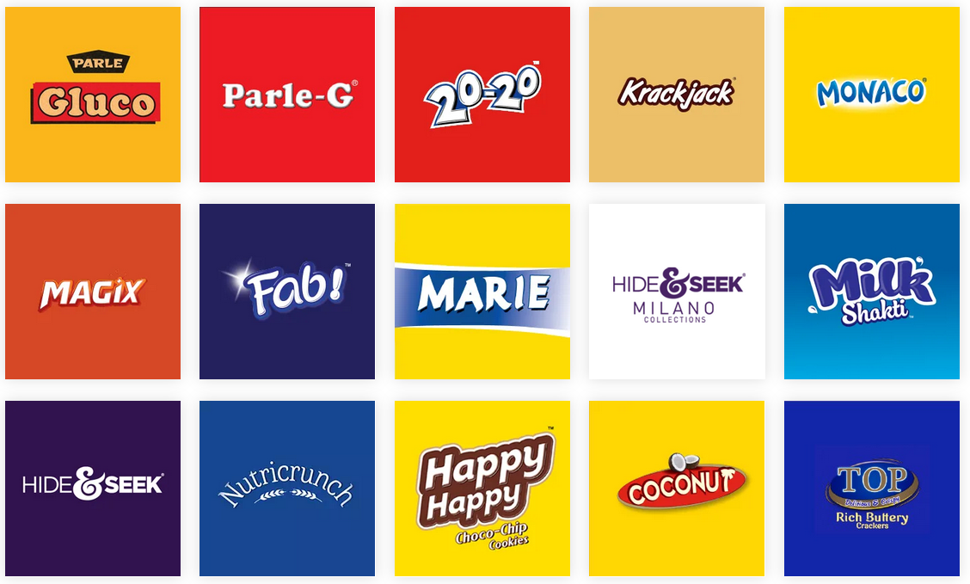
Company's portfolio of products
Parle Products, established in 1929, is a prominent Indian food company renowned for its diverse range of products. Their portfolio encompasses several categories:
1. Biscuits
Parle-G Gluco
Parle-G
20-20 Cookies
KrackJack
Monaco
Magix Creme
Fab! Range
Parle Marie
Hide & Seek Milano
Milk Shakti
Hide & Seek
Nutricrunch
Happy Happy
Parle Coconut Biscuits
Parle Top

Slide 6
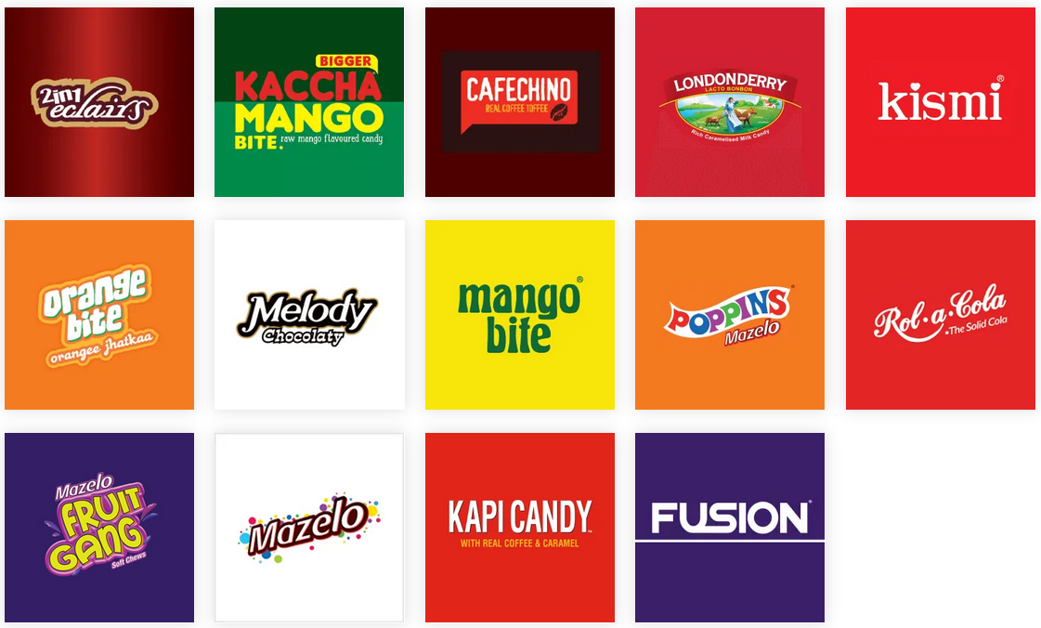
Company's portfolio of products
2. Confectionery
2 in 1 Eclairs
Kaccha Mango Bite
Cafechino
Londonderry
Kismi
Orange Bite
Melody
Mango Bite
Poppins
Rol-a-Cola
Mazelo Fruit Gang
Mazelo
Kapi Candy
Fusion New

Slide 7
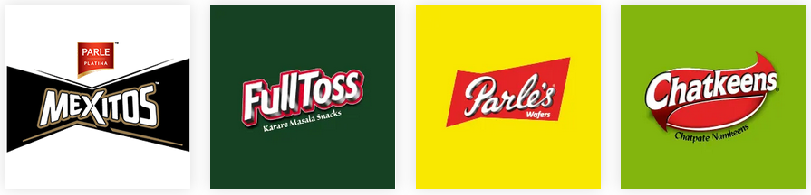

Company's portfolio of products
3. Snacks
Mexitos
Fulltoss
Parle's Wafers
Chatkeens
4. Cakes
Happy Happy Cakes

Slide 8
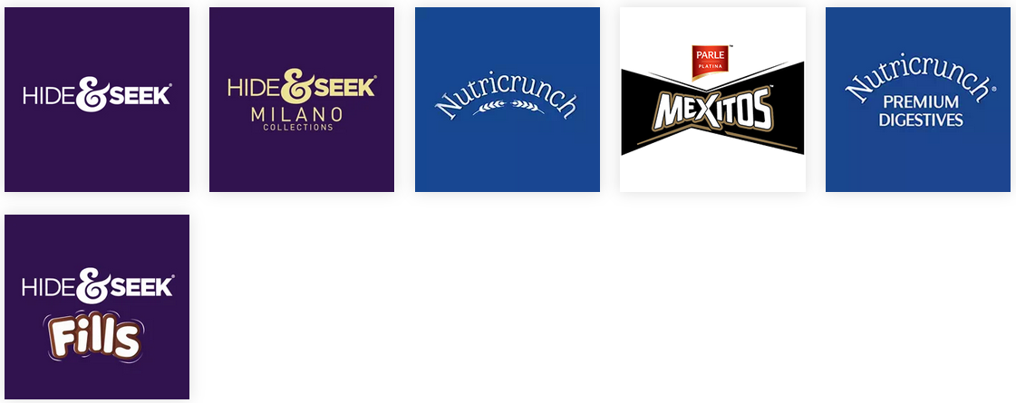
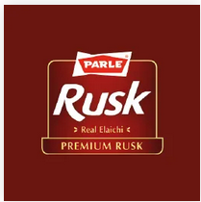
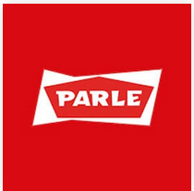
Company's portfolio of products
5. Platina Range
Hide & Seek
Hide & Seek Milano
Nutricrunch
Mexitos
Nutricrunch Premium Digestive
Hide & Seek Fills
6. Rusk
7. Atta
Parle Rusk
Atta

Slide 9


Company's portfolio of products
8. Breakfast Cereals
Hide & Seek Fills
ASAP
9. Others

Slide 10
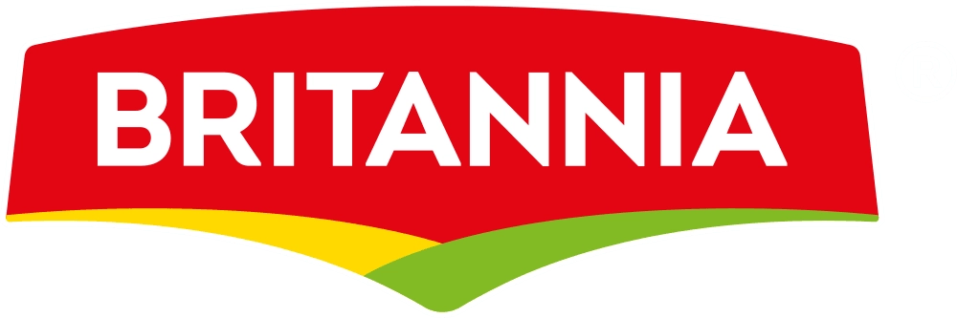









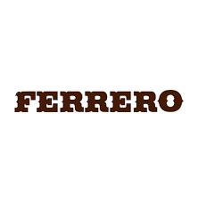


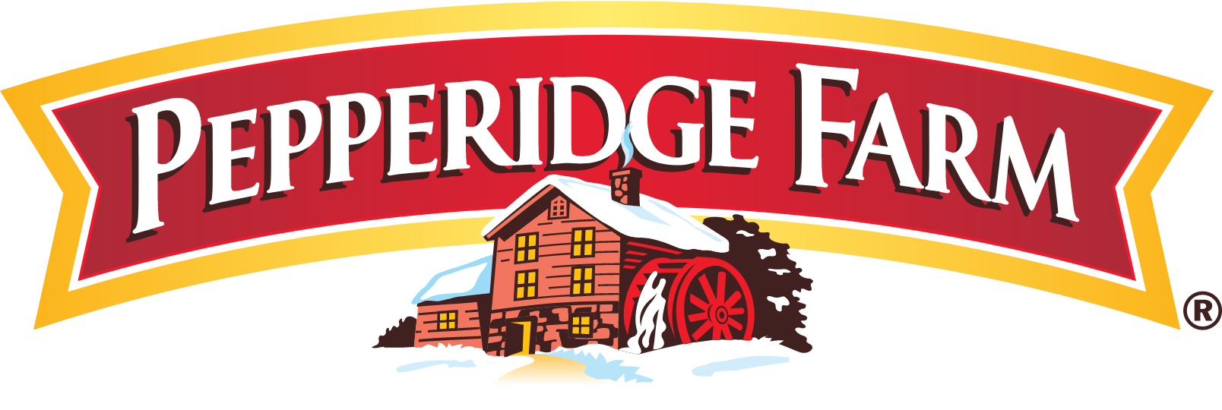
Competitors in market
Outside India
In India
A. Biscuit Segment
B. Confectionery Segment
A. Biscuit Segment
B. Confectionery Segment

Slide 11
Competition in market
⚔️ Competitive Weapons
Price War:
Parle-G’s ₹1 pack vs Britannia’s ₹5 Tiger (rural edge)
Innovation Arms Race:
Hide & Seek vs Britannia NutriChoice
Platina vs ITC Dark Fantasy
Distribution Might:
Parle: 6M+ kiranas | Britannia: 4M (urban focus)
🔥 Hot Zones
Rural: Parle dominates (Britannia playing catch-up)
Urban Premium: Parle struggling (Oreo/ITC lead)
Health Segment: Britannia’s NutriChoice vs Parle’s Simply Good
Brand | Segment | Market Share | Price Range (100g)
Parle-G | Glucose | 80% | ₹5-15
Britannia Tiger | Glucose | 12% | ₹8-20
ITC Sunfeast | Cream | 5% | ₹15-30
Mondelez Oreo | Premium Cookies | 3% | ₹30-50

Slide 12

Business strategy
Emotional Branding : Bachpan ka Biscuit – Symbol of Childhood memories.
Affordable Pricing & Penetration Strategy – Ruppe 1 pack in 1960s.
Mass distribution Excellence – Rural First Approach
Strategic Marketing Campaign – Localized ads in regional language.
Limited Expending on Celebrity endorsements.
Product line diversifications – Every product positioned health-conscious (Simply Good), premium (Parle-G Gold), or kids (Poppins).

Slide 13
Financial strategy
. Pricing Power: ₹5 price point (unchanged for 10+ years)
Rural-First Revenue: 60% sales from villages → Steady demand despite inflation
Global Profit Pools: Africa, Middle East: 20% export revenue
Financial Highlights (FY24)
Metric | Value
Revenue | ₹12,000 Cr (+14% YoY)
Operating Margin | 18% (vs Britannia’s 15%)
Market Share | 80% in glucose segment

Slide 14
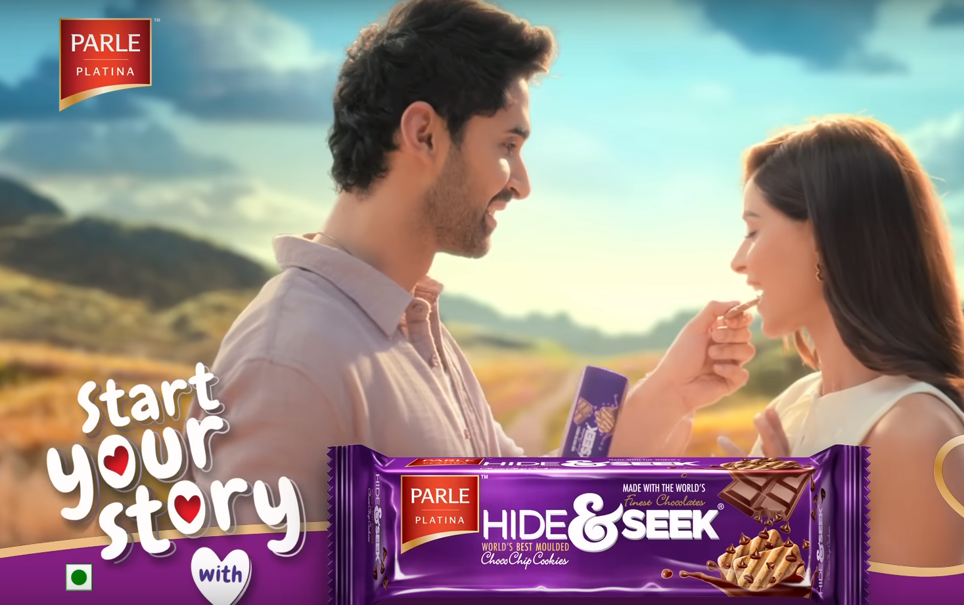
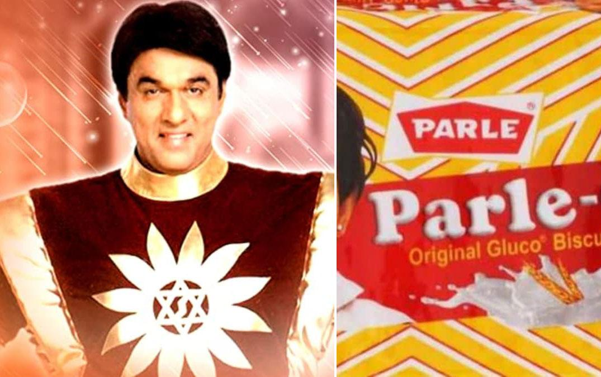
Marketing Genius: How Parle-G Won India’s Heart
1. The ₹1 Psychological Pricing (1960s)
Strategy: Made biscuits accessible to all income groups
Impact: 70% of rural India could afford daily packets
2."G for Genius" Campaign (1990s)
Tagline: "Hindustan ki Taakat" (India’s Strength)
Execution: School toppers featured in ads
Result: Became synonymous with "smartness“
3. Rural Marketing Masterstroke
Tactics:
Kirana store wall paintings ("Parle-G wale bhaiya")
Regional language ads (e.g., "Genius" in 12 languages)
Outcome: 60% sales from villages
4.collaborate with shaktiman in tamil nadu: 50 ton to 2000 ton per month

Slide 15
Supply chain mastery
Pan-India Network
10+ factories, 5,000+ distributors
Covers 6.3 lakh villages (deepest rural penetration)
Kirana Power
Supplies 1.5M+ small stores daily
"Last-mile" delivery via bicycles/bullock carts
Crisis Resilience
COVID lockdowns: Operated at 90% capacity
Floods/rains: Pre-stocked warehouses
Cost Control
Local wheat sourcing → 15% cheaper vs competitors
Zero cold storage (shelf-stable product)
Tech Edge
AI demand forecasting (reduces wastage by 20%)
RFID tracking for trucks

Slide 16
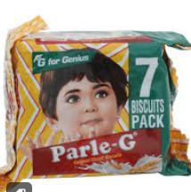
Case Study Management Principles- Parle-G’s ₹1 Strategy
Management Principle: Customer-Centric Approach -common man as its primary customer- ₹1 Parle-G biscuit -lowest income group.
Principle: Scientific Decision Making-small packs had the highest turnover in rural-focused on optimizing pack size, reducing packaging cost.
Principle: Stability and Discipline -Parle-G’s taste and packaging remained the same for decades.

Slide 17
Case Study Management Principles- Parle-G’s ₹1 Strategy
Principle: Unity of Direction - "Make affordable, quality biscuits for all Indians.“
Outcome
Brand Loyalty: Over 80% of Indian households
Global Recognition: Parle-G became the world’s best-selling biscuit by volume (Nielsen Report).
Trust Capital: Unshaken trust even during market disruptions like the COVID-19 pandemic.

Slide 18
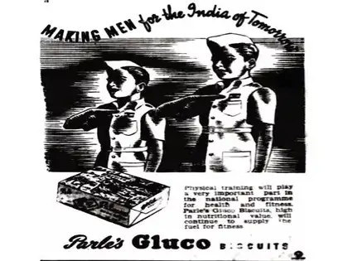
Emotion over branding How Parle-G Won Hearts, Not Just Markets
1. Nostalgia as a Strategy
Generational Bond: "Taste of childhood" since 1939
Visual Consistency: Same red-yellow packaging for 50+ years
Campaigns: "#GharWaliFeeling" (2023) evoked mom’s tea-time memories
2. Patriotism & Trust
Swadeshi Legacy: Marketed as "India’s biscuit" since British era
Crisis Moments:
2020: "Ghar Ka Ration" positioned as pandemic essential
1971 War: Supplied to Indian troops as "energy bars"
3. Rural Emotional Connect
Mascots: "Chotu-Genius" village boy ads (1990s)
Localized Ads: Regional language jingles ("G for Genius" in 12 dialects)

Slide 19
Parle Products: Annual Report
For Financial Year ending on 31 March, 2023
Operating revenue range : INR 100 cr - 500 cr
Earnings Before Interest, Taxes, Depreciation, and Amortization: decreased by 1.28% over the previous year
Book networth has decreased by 2.51%

Slide 20
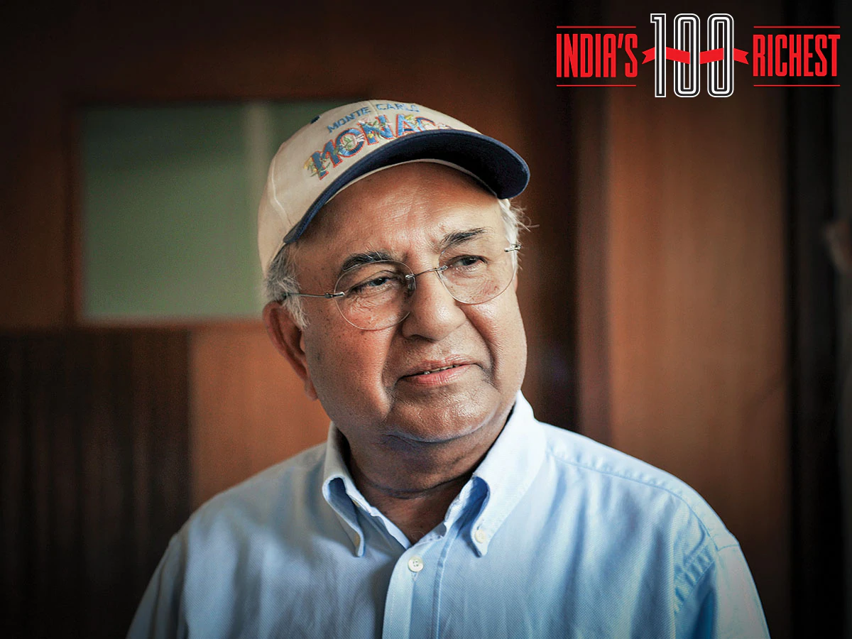
Leadership
Steering the Ship (2024)
Chairman: Vijay Chauhan (3rd Generation)
MD: Prakash Chauhan
Key Trait: "Slow but Stable" growth philosophy
📜 Governance Hallmarks
Anti-FDI Stance:
Rejected $1B Unilever buyout (2013) to retain Indian ownership
Decentralized Control:
Regional factories make local decisions (e.g., wheat sourcing)
Nostalgia-Driven R&D:
All product launches must pass "Taste Legacy" test
📊 Performance Under Leadership
Vijay Chauhan(Chairman)

Slide 21

Diversification: Hits & Misses
Failure
Success Stories
Hide & Seek (1990s)
India’s 2nd largest chocolate biscuit
Why? Leveraged Parle’s distribution + kid-friendly positioning
Melody (1980s)
"Chocolatey Surprise" tagline made it a cult favorite
Secret: Used leftover biscuit crumbs in filling
Monaco (2000s)
"Salted Snack" niche beat Britannia’s 50-50
Data: 18% share in salty biscuits (2024)
❌ Costly Failures
Parle Pizzas (2010)
Flopped in 6 months – Why? No oven-ready distribution
Caffe Creme (2015)
Coffee biscuits – Issue: Too niche vs Parle-G’s mass appeal
Proteins (2022)
"Healthy" range – Reality: Customers wanted nostalgia, not protein

Slide 22
Premium Play: Parle’s Uphill Battle
Why Go Premium?
Market Demand: 22% growth in premium biscuits (2023)
Competition: Britannia (Good Day), ITC (Dark Fantasy)
Margins: 2X profit vs regular Parle-G
Parle-G Gold (2023)
USP: "Richer taste, same trust"
Hurdle: Consumers saw Parle-G as "affordable" brand
Why pay more?
Hide & Seek Black (2021)
Premium chocolate variant
Issue: Lost to Cadbury Oreo’s stronger luxury appeal
Simply Good (2020)
"Healthy" range (less sugar, multigrain)
Reality: 80% buyers still chose classic Parle-G

Slide 23
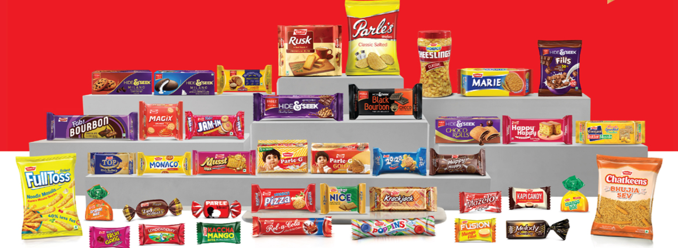
Future Plan of Company
1. Health and Wellness Product Expansion- health-conscious alternatives: multigrain, digestive, sugar-free biscuits.
2. Global Market Expansion -Increasing exports in Africa, Middle East, Southeast Asia
3. Building Parle as a "Global Indian Brand" like Amul or Tata
3. Deepening Rural Penetration :Launching ₹1-₹5 SKUs to maintain affordability amid inflation
4. Digital Transformation and E-commerce Push: Tying up with platforms like BigBasket, Amazon, JioMart
5. Revamp of Confectionery Segment : Innovation in flavors and packaging for brands like Melody, Kismi, Mango Bite.
6. Sustainability and Eco-Friendly Initiatives : Working towards biodegradable packaging

Slide 24
References
https://www.financialexpress.com/life/lifestyle-introducing-the-family-behind-indias-rs-17223-crore-company-home-to-the-iconic-parle-g-3370404/
https://www.parleproducts.com/
https://economictimes.indiatimes.com/opinion/et-commentary/parles-long-journey-from-being-a-swadeshi-brand-to-a-modern-product/articleshow/93529082.cms?from=mdr
https://www.tofler.in/parle-products-private-limited/company/U15400MH1950PTC008334

